Slide 1
Role of Data Analytics to overcome Challenges in Supply Chain Management
MSc Research Project
MSC Data Analytics
Supervisor: Arjun Chikkankod
Muddassir Ahmed x23138688

Slide 2
Introduction:
Supply chain management is facing big challenges in Logistics. In my Research work, I’m trying to find how data analytics can be use in supply chain management specific in demand forecasting of the products and late deliveries of the shipment.
  Data Analytics: Offers solutions to enhance prediction accuracy and operational efficiency.

Slide 3
Research Question:
1) Predicting Demand (Sale): How accurately can we forecast sales using OLS linear regression based on various order-related and customer-related features?
2) Late Deliveries: Which classification algorithm performs best in predicting late delivery risk based on order and customer data?

Slide 4
Methodology Overview
Regression Model: OLS regression for predicting demand based on past sales data.
Classification Models: Random Forest, Support Vector Machine, Logistic Regression, Linear Discriminant Analysis and Gaussian Naive Bayes to analyze late deliveries.

Slide 5
Business Implications
Demand Forecasting: Data Analytics can help in better planning and resource allocation.
Late Deliveries: It can enhance the ability to address and prevent delays, improving customer satisfaction.
Overall Benefit: Contributes to overall supply chain efficiency and cost reduction.

Slide 6
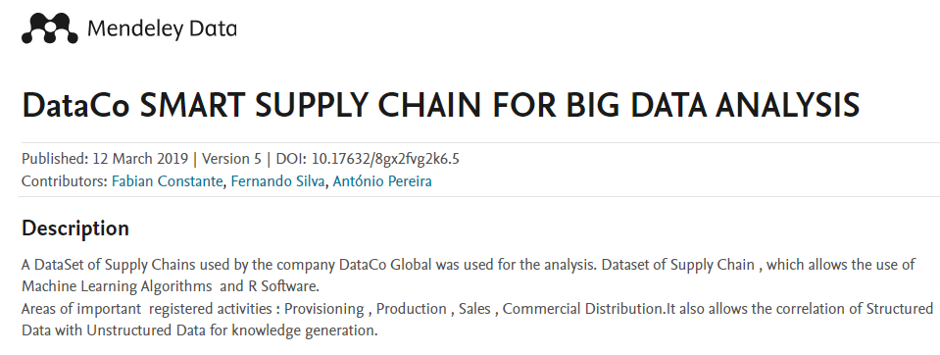
Dataset Analysis:
We have selected Mendeley Dataset which is publically available ‘https://data.mendeley.com/datasets/8gx2fvg2k6/5’
  Size: 180,518 rows, 53 columns
  Missing values, numeric values, categorical values etc

Slide 7
Data Preparation:
Handling missing values:
1. Names were missing, Filled with Not determined
2. Zip code missing values, Filled with 0
3. Order zip code value missing, Filled with 0
Dropping Columns:
Irrelevant columns were dropped
Combining Columns:
First name and Last name column were combined

Slide 8
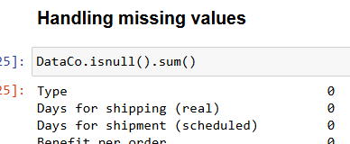

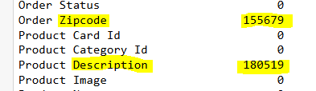

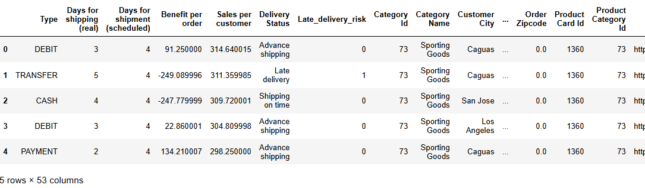
Data Preparation:

Slide 9
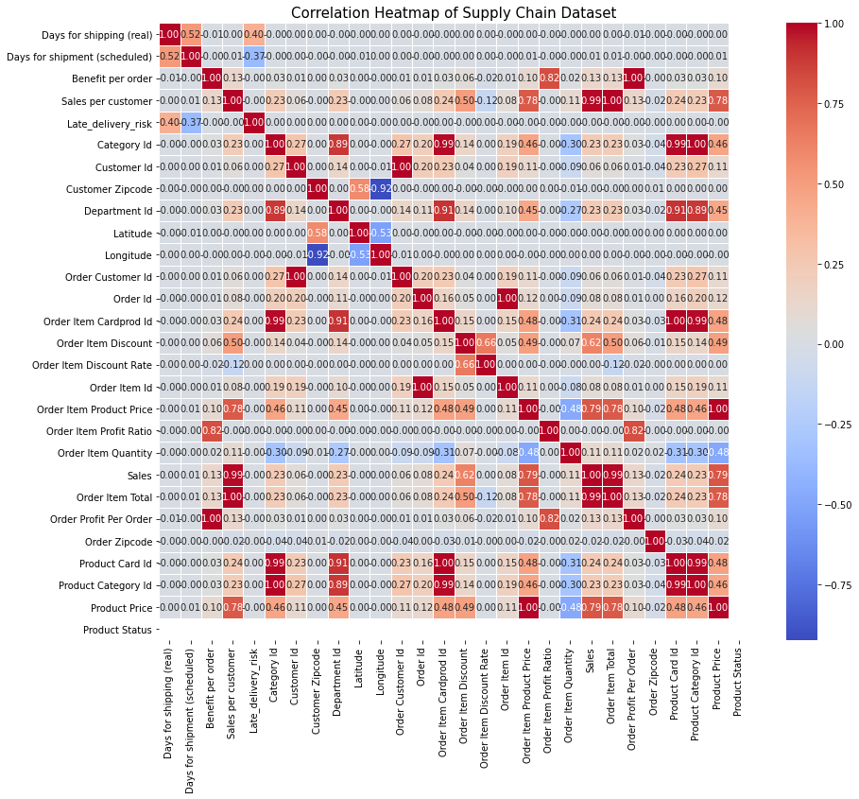
Correlation Matrix:

Slide 10
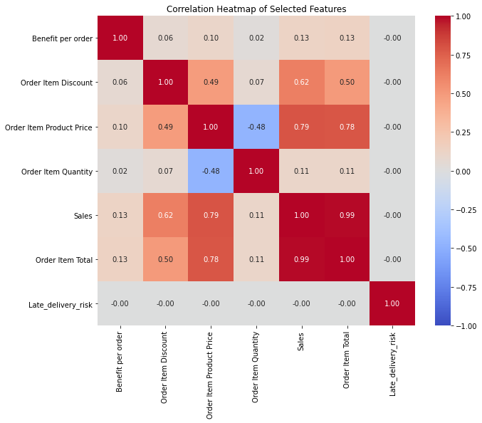
Correlation Matrix: Selected Features

Slide 11
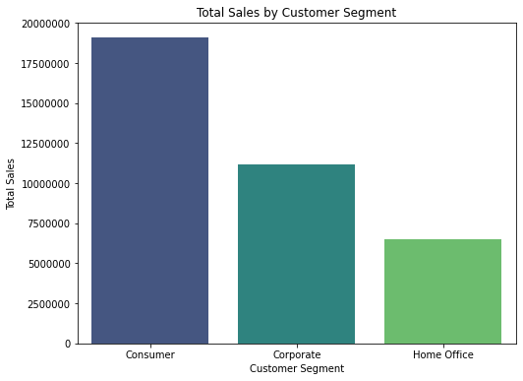
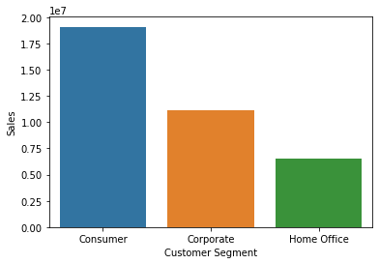
Exploratory Data Analysis: Sales
Customer Segment Analysis: Sales

Slide 12
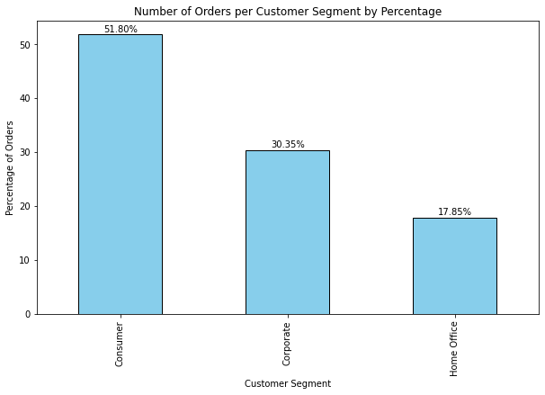
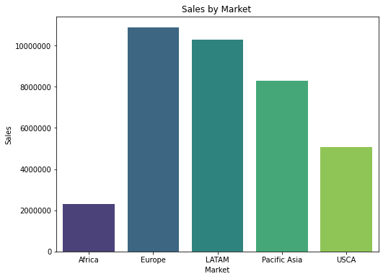
Exploratory Data Analysis:
Customer Segment Analysis: Sales

Slide 13
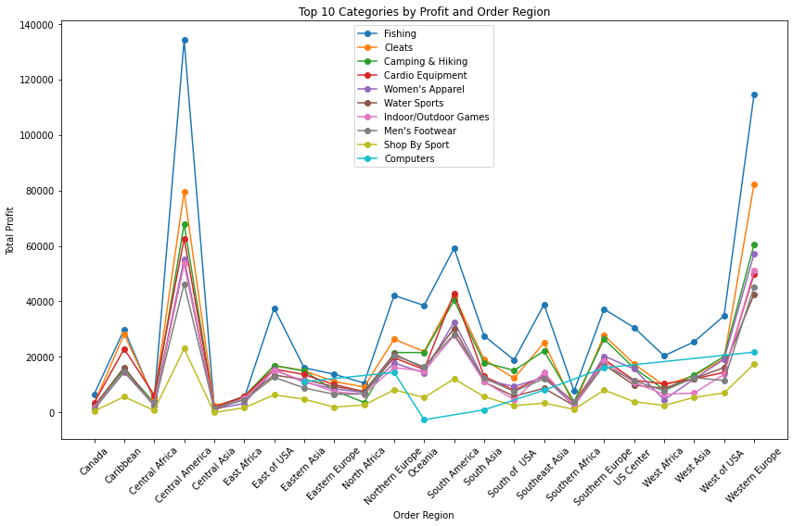
Exploratory Data Analysis:

Slide 14
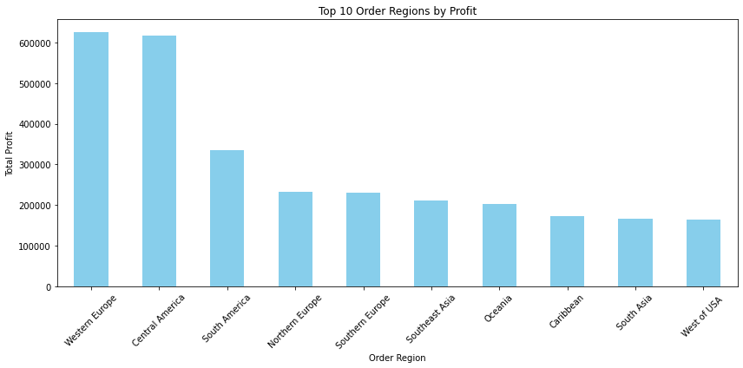
Exploratory Data Analysis:

Slide 15
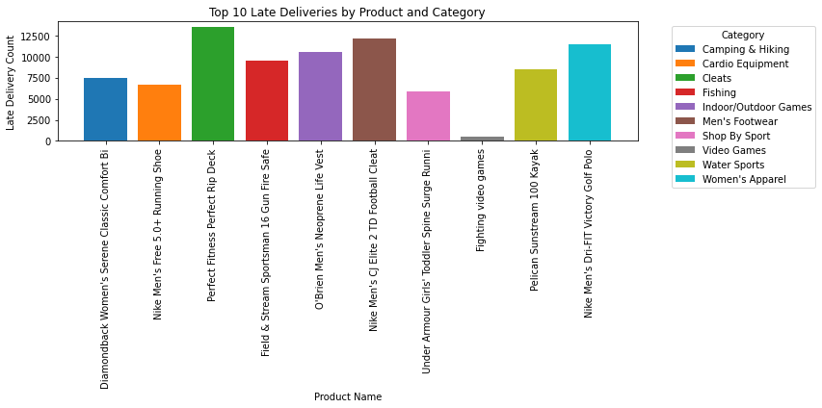
Exploratory Data Analysis: Late Delivery

Slide 16
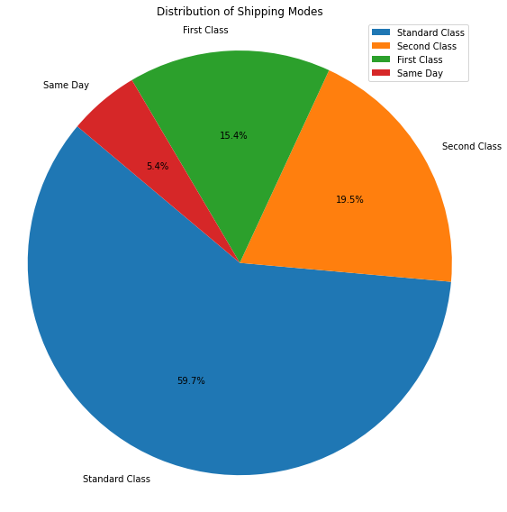
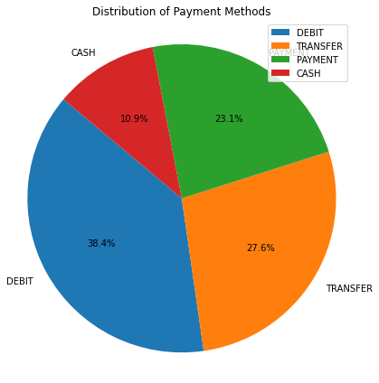
Exploratory Data Analysis: Late Delivery

Slide 17
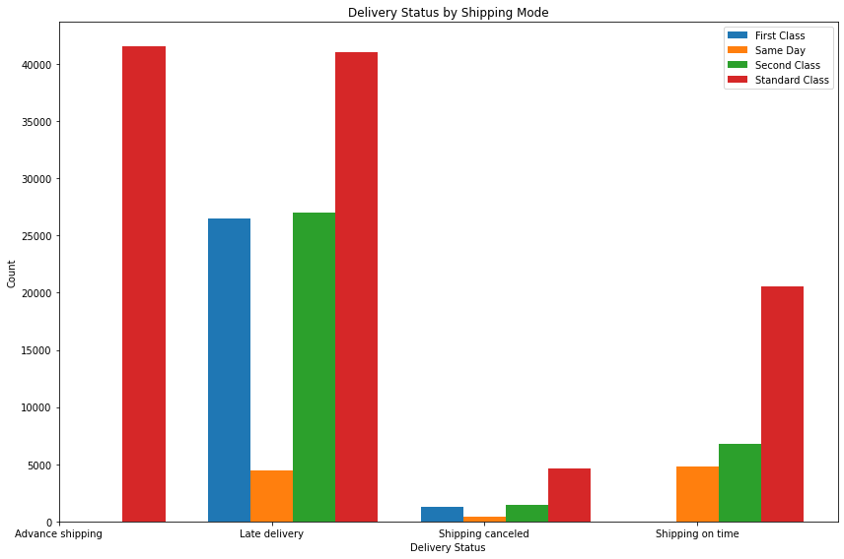
Exploratory Data Analysis: Late Delivery

Slide 18
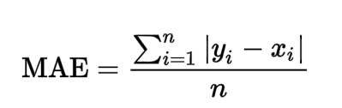
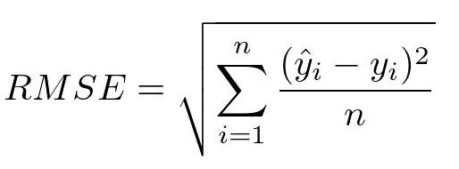
Modeling: OLS Regression
Ordinary Least Square (OLS) regression
This model is used to estimate coefficient, Standard Error of linear regression. We are evaluating models using metrics such as Mean Absolute Error (MAE) and Root Mean Square Error based on sales of the dataset.

Slide 19
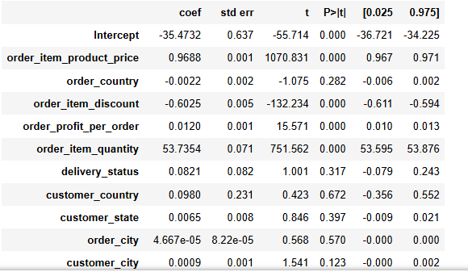
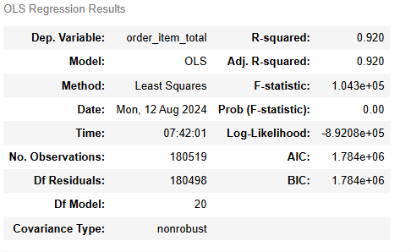
OLS Coefficient and Standard Error

Slide 20

Regression Result Comparison

Slide 21
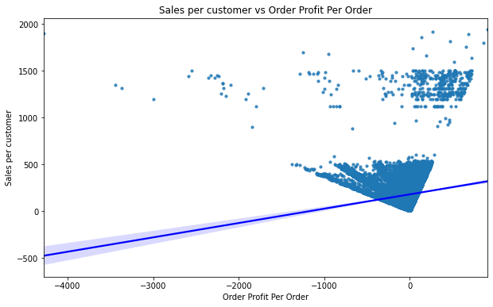
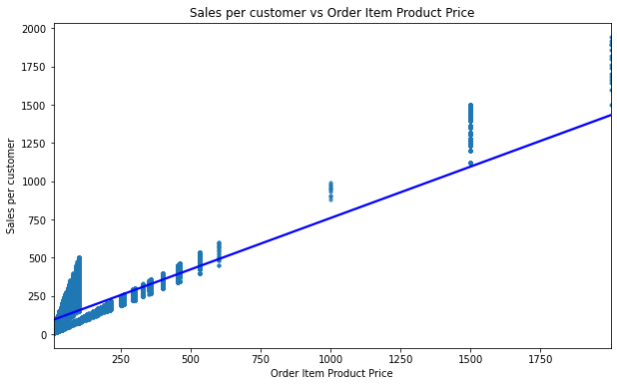
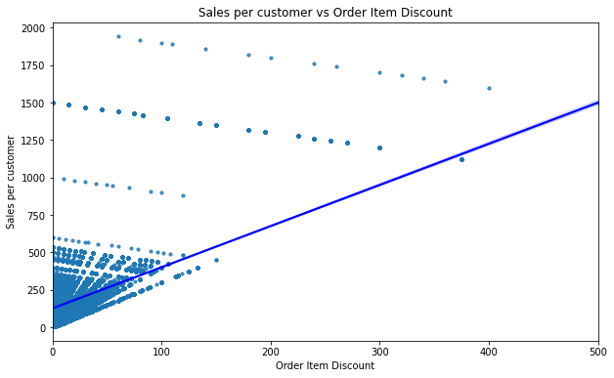
Result: Diagram

Slide 22
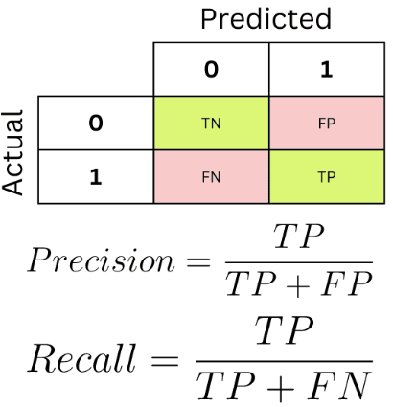
Modeling: Classification
Classification Models: Late Delivery analysis
Random Forest, Support Vector Machine, Logistic Regression, Linear Discriminant Analysis, Gaussian Naive Bayes.

Slide 23
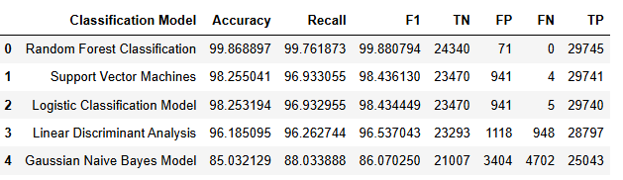
Classification Result Comparison

Slide 24
Thank You

